Slide 1
The Rise of the Machines
by Peter DeMartini
Your feedback is important to us
Please text @T63 to 39242
Thank you!

Slide 2
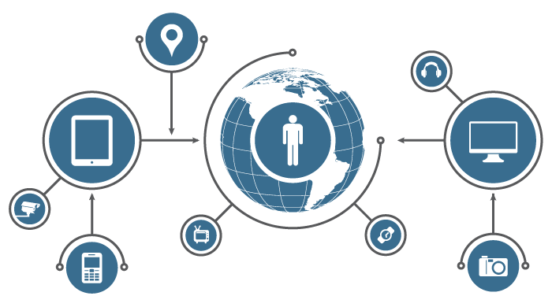
What is the
Internet of Things?

Slide 3
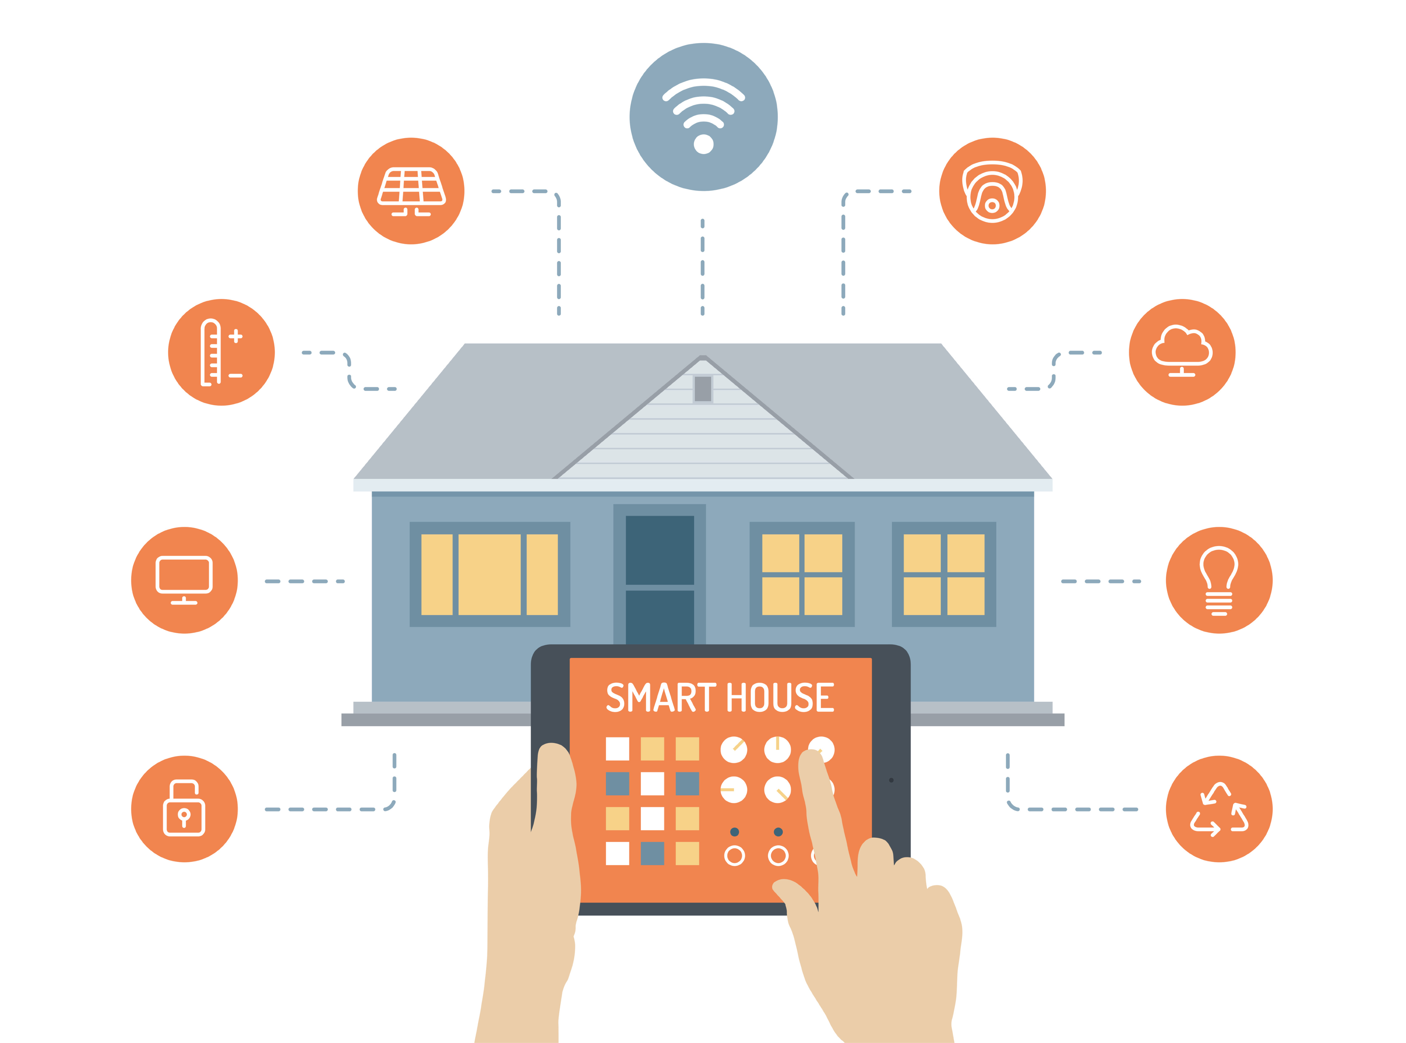
Smart Devices, Connected to Everything

Slide 4
“The Internet of Things has the potential to change the world, just as the internet did. Maybe even more so.”
~ Kevin Ashton

Slide 5
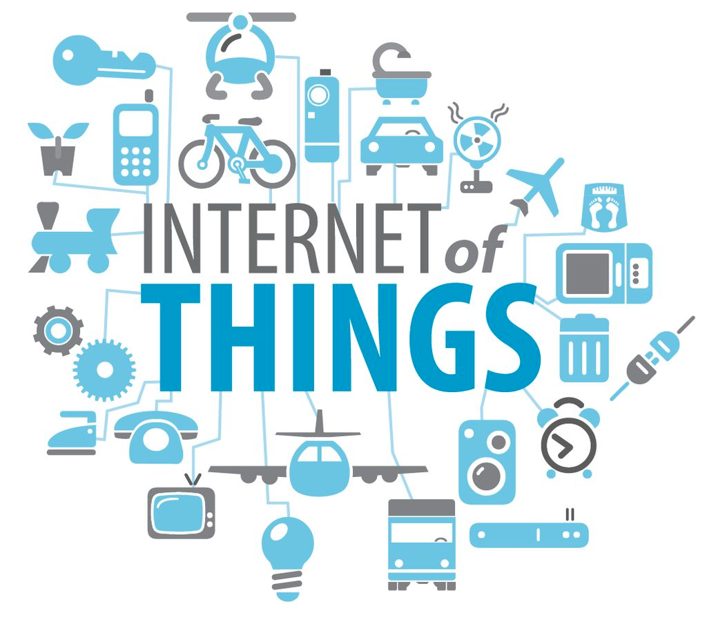
- Device Intelligence
- Automation
- Growth

Slide 6
Today: 1.9B connected devices. 50B estimated by 2020.

Slide 7
By 2020, the IoT market value is predicted to be between $3T and $14T

Slide 8
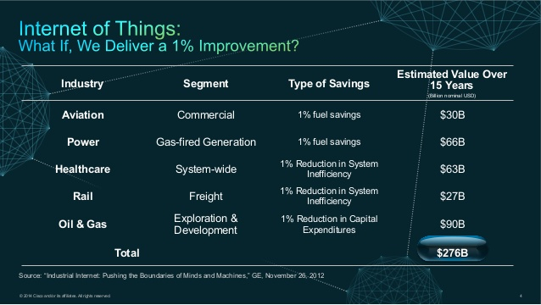

Slide 9
IoT & Business Automation

Slide 10
“Everything that can be automated, will be automated.”
~ Robert Cannon

Slide 11
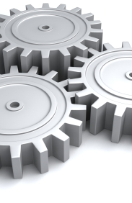
Automation
Let machines do the hard work

Slide 12
Machine Learning
Anomaly detection
Event prediction
Context aware systems

Slide 13
Human Interaction
Humans have the power of personality and creativity, automate the rest.

Slide 14
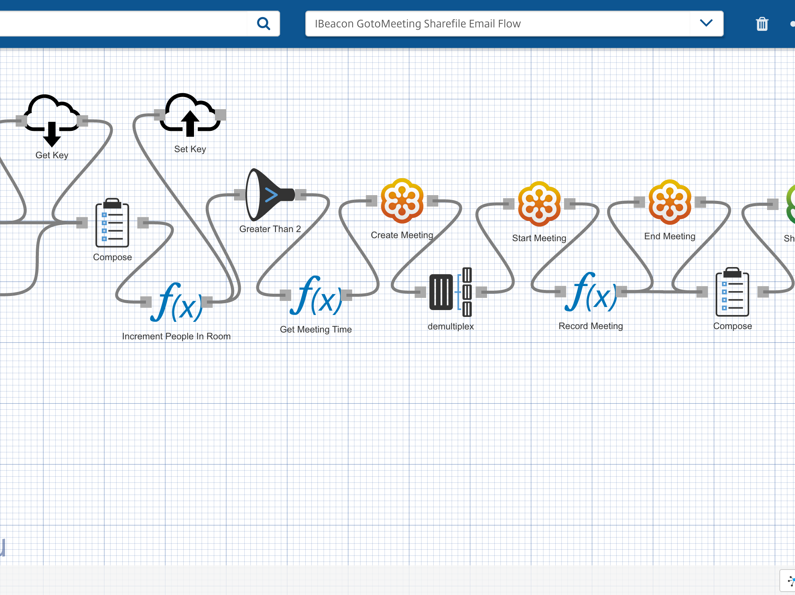

Octoblu
The Internet of Things operating system

Slide 15
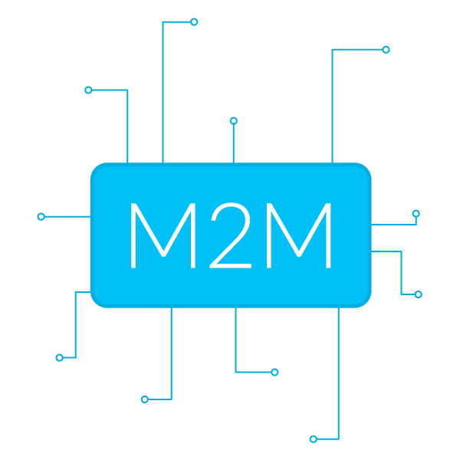
Talking to devices is hard, we make it easy

Slide 16
Connect, Design, Compute, and Analyze

Slide 17
With the rise of machines how do humans communicate?

Slide 18


Slide 19
A collection of services designed to engage human interactions.

Slide 20
Impact
Save man hours
Security
The power of IoT
Smart devices, smart people

Slide 21
Lessons Learned

Slide 22
Be Lazy

Slide 23
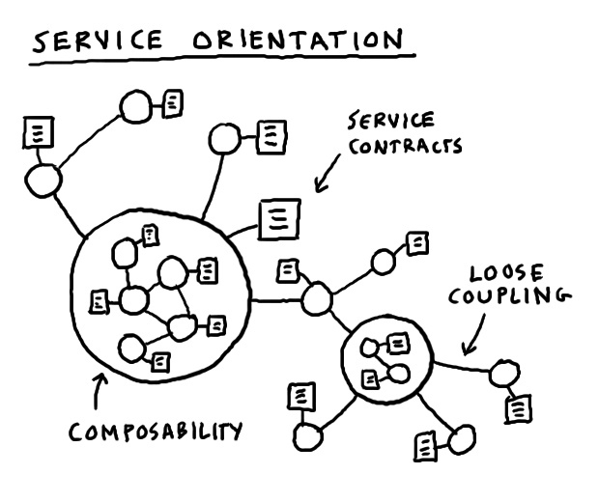
Microservices
Complex applications written in small independent programs

Slide 24
Machines cost far less than humans

Slide 25
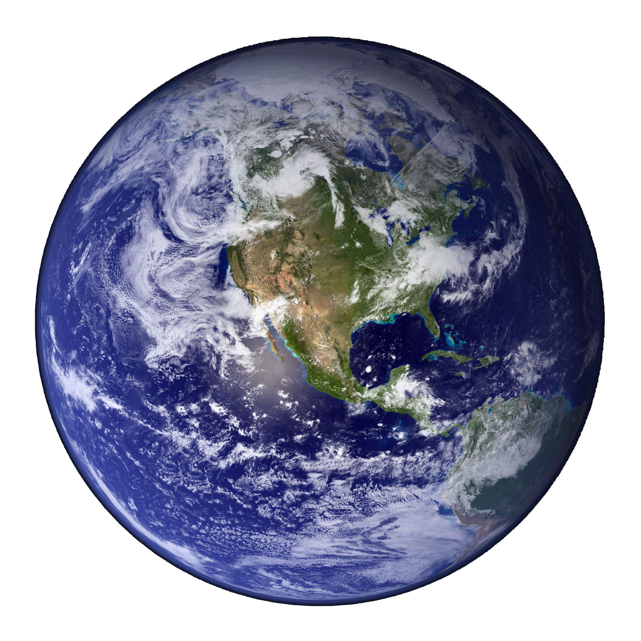
Make the world a better place

Slide 26

Let humans do what they do best

Slide 27
Your feedback is important to us
Please text @T63 to 39242
Thank you!
Peter DeMartini
Twitter: @PeterDeMartini
Email: p@octoblu.com
Slide Deck available at
https://github.com/peterdemartini/rise-of-the-machines-talk/

